Slide 1
Project 1 : EAT (AKA: BEATS)
Brian Sandoval
Erik Blomquist
Alexander Enaceanu (Lead)
Tyler Kluszczynski
Shahid Karim

Slide 2
Project Overview
7 Main Objectives.
Delete AWS resources from Project 0.
Terraform IAM.
Terraform VPC.
Terraform Infrastructure.
S3.
Application load balancer.
Ansible.

Slide 3
Team Overview
Tasks allocated to each team member:
Name | Tasks
Brian | Terraform S3,Ansible
Erik | Terraform VPC, Ansible
Alex | Terraform EC2, VPC, Ansible
Tyler | Terraform IAM, ALB, Route 53, Improve GitHub instructions
Shahid | Ansible, Learn GitHub and AWS.

Slide 4
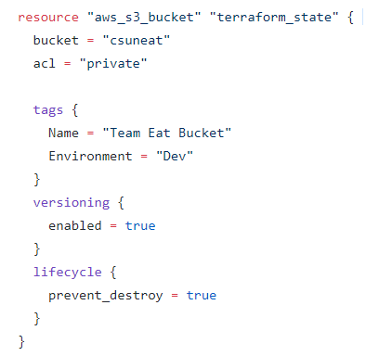
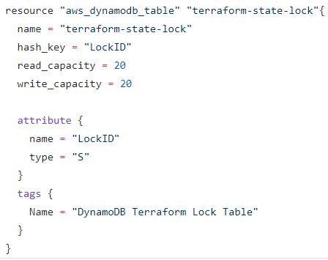
Brian - Tasks

Slide 5
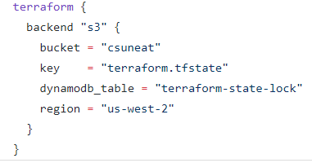
Brian - Tasks

Slide 6
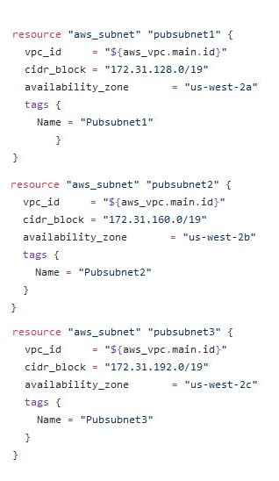
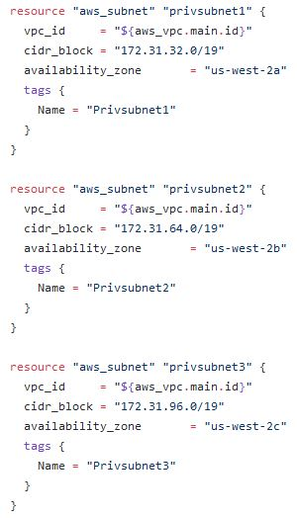
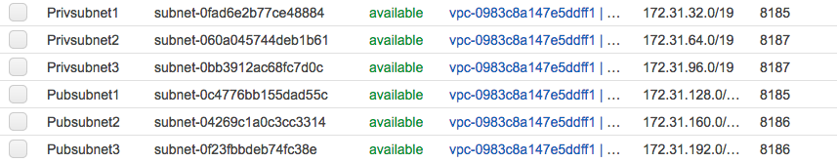
Erik - Tasks
Terraform VPC - Subnets

Slide 7
Erik - Tasks
Key Pairs - Converted with PuttyGen - Distributed
Ansible - Problems with local local machines - tarball

Slide 8
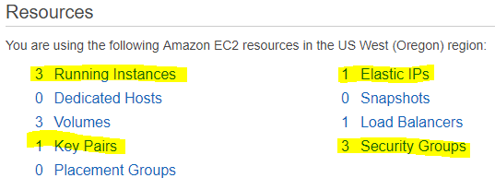
Alex - Tasks (Terraform EC2, VPC, Ansible)
Overview

Slide 9

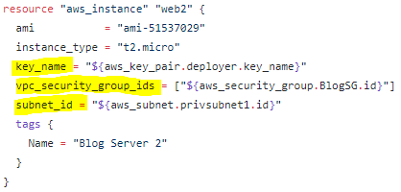
Alex - Tasks (Terraform EC2)
Blog Servers

Slide 10

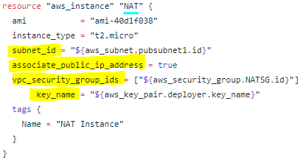
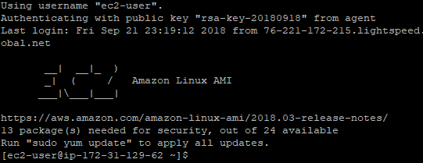
Alex - Tasks (Terraform VPC)
NAT Instance/Bastion jump

Slide 11
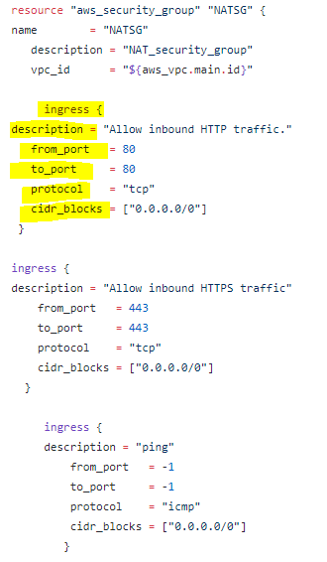
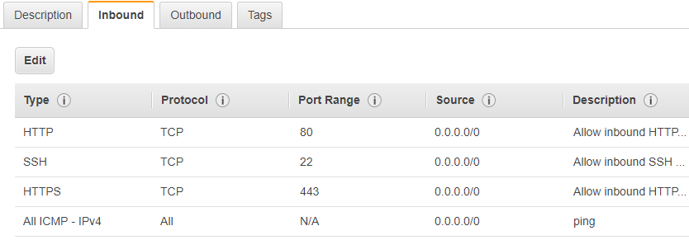
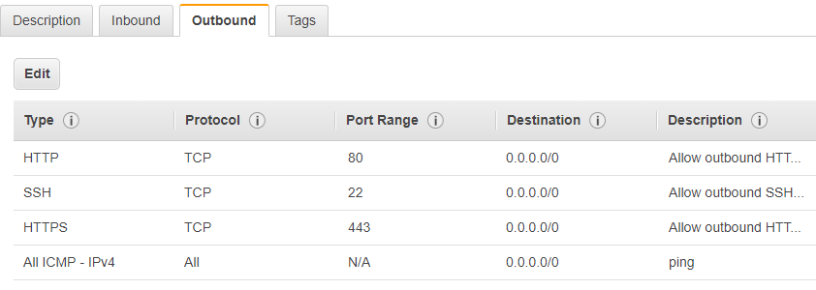
Alex - Tasks (Terraform VPC)
NAT Instance/Bastion Jump Security Group (Public Subnet 1)

Slide 12
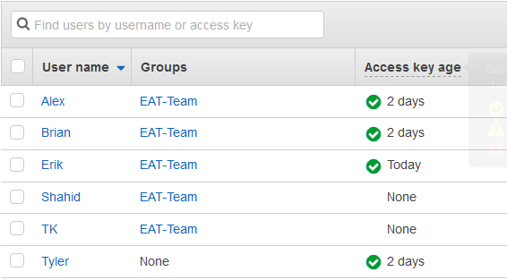
Tyler - Tasks (IAM Users and Groups)

Slide 13
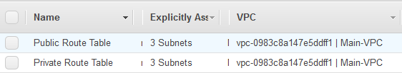
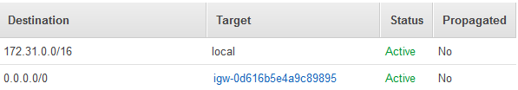
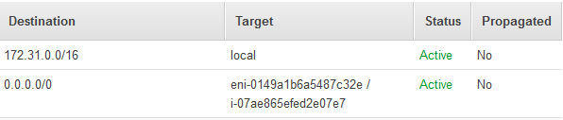
Tyler - Tasks (Route Tables)
Public:
Private:
Nat Instance

Slide 14
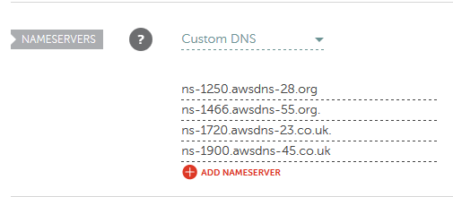
Tyler - Tasks (Route 53 - Namecheap Setup)

Slide 15

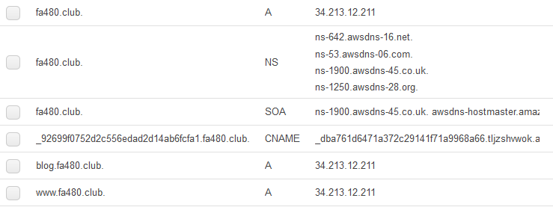
Tyler - Tasks (Route 53)
Only 1 Zone:

Slide 16
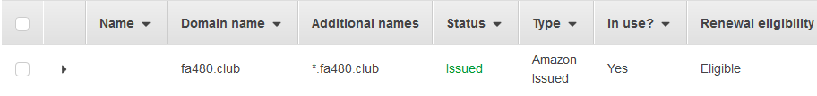
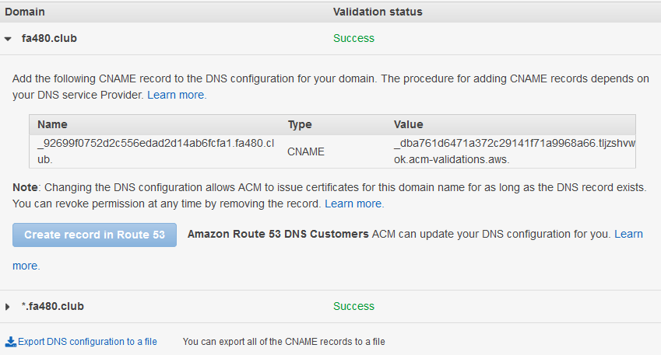
Tyler - Tasks (Certificates - AWS Cert)

Slide 17

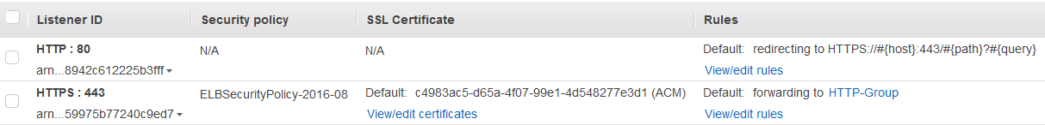
Tyler - Tasks (ALB)
redacted

Slide 18

Tyler - Tasks (Target Groups)

Slide 19
Shahid - Tasks (Ansible)
What is Ansible?
Ansible is an automation tool that can be deployed on multiple hosts at once. Running scripts on each host that needs tasks to be done is very slow and is not safe. Ansible intelligently checks to see if the task has already been performed. It then runs each task on all hosts requiring said tasks to be run. There’s a method to group hosts based on certain tasks that need to be completed.

Slide 20
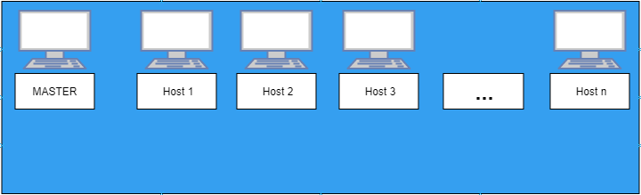
Shahid - Tasks (Ansible)
Why use Ansible?

Slide 21
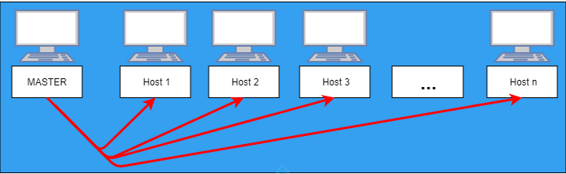
Shahid - Tasks (Ansible)
Why use Ansible?

Slide 22
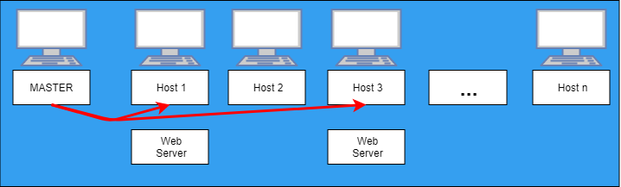
Shahid - Tasks (Ansible)
Why use Ansible?

Slide 23
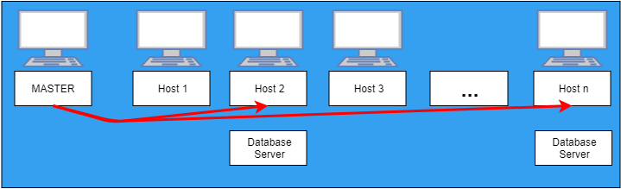
Shahid - Tasks (Ansible)
Why use Ansible?

Slide 24
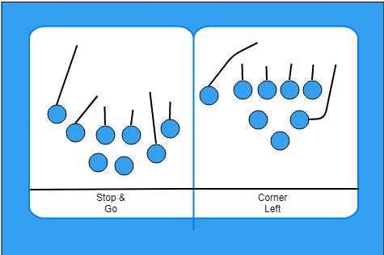
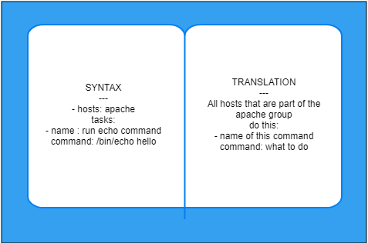
Shahid - Tasks (Ansible)
How does Ansible work?

Slide 25
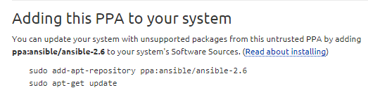
Shahid - Tasks (Ansible)
How to install Ansible?
https://launchpad.net/~ansible/+archive/ubuntu/ansible-2.6
ansible --version

Slide 26
Issues and Lessons Learned
We encountered 5 major issues throughout Project 1.
No one had experience with Terraform or Ansible.
We mainly researched using Google, and asked many questions to the professor.
Even with the time extension, we were on a tight time table.
Each team member worked 20+ hours. We worked over both weekends.
EC2 instances weren't running until Monday (17th).
Alex, Tyler and Brian stayed after class hours to get them running on Monday.
Our team didn't know how to use GitHub for pull requests and branching.
Tyler made new instructions, and updated the team.
Work wasn't done as efficiently as we would have liked.
Next project, we will spend more time formulating a work plan.
More information on the following slides.

Slide 27



How our team will change for the next project.
Currently, If a team member needs help, the person helping them has less time to complete their own tasks.
Next project, assign a "dedicated backup," to help everyone with their tasks.
Can be assigned to 1 difficult task.
Can ask the professor questions if a group member is absent.
Can assist a sub-team that may be "swamped" with work.
Should be knowledgeable about the entire project (normally the team lead).
Bottlenecks such as EC2 instances stopped group members from completing their tasks (such as working on Ansible and the ALB).
See how this will be fixed on the following slides.

Slide 28
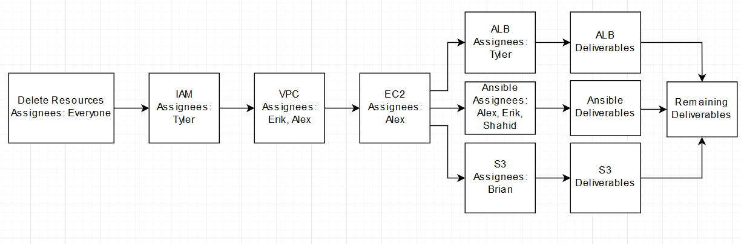
Project 1 - How it was actually done.
Bottlenecks.
Other team members can't do their work.

Slide 29
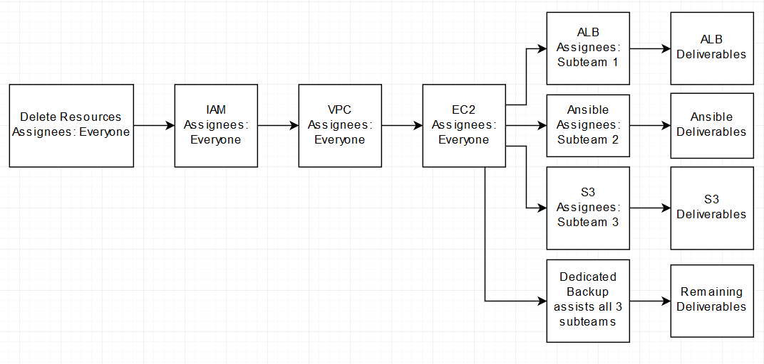
Project 1 - Example using the new system.
No Bottlenecks!
Everyone is working at the same time.

Slide 30
Project Demonstration

